Slide 1





Please set your chatbox to Everyone and introduce yourself!
Let us know who you are,
where you’re joining from, and what you’re hoping to learn today.
Intro to Python
with General Assembly

Slide 2

Instructor Name
Your Title and Company
Short bio info
Notes:
Add your photo, title, and company here
Touch on your experience with GA - be it teaching, learning or both
Add some sort of fun fact - hobby, family, pets, blog, etc...

Slide 3


What is
General Assembly?
Notes:
“So, you’re here for a class with General Assembly, but if you’ve never been here before, you might be wondering “What exactly is General Assembly?”
General Assembly (or GA, as we like to call it) was founded in NYC 2011 as a coworking hub for innovators and entrepreneurs.
When our members were asked to share their expertise with one another through impromptu classes and workshops, the potential and power of peer-to-peer mentorship emerged.”

Slide 4
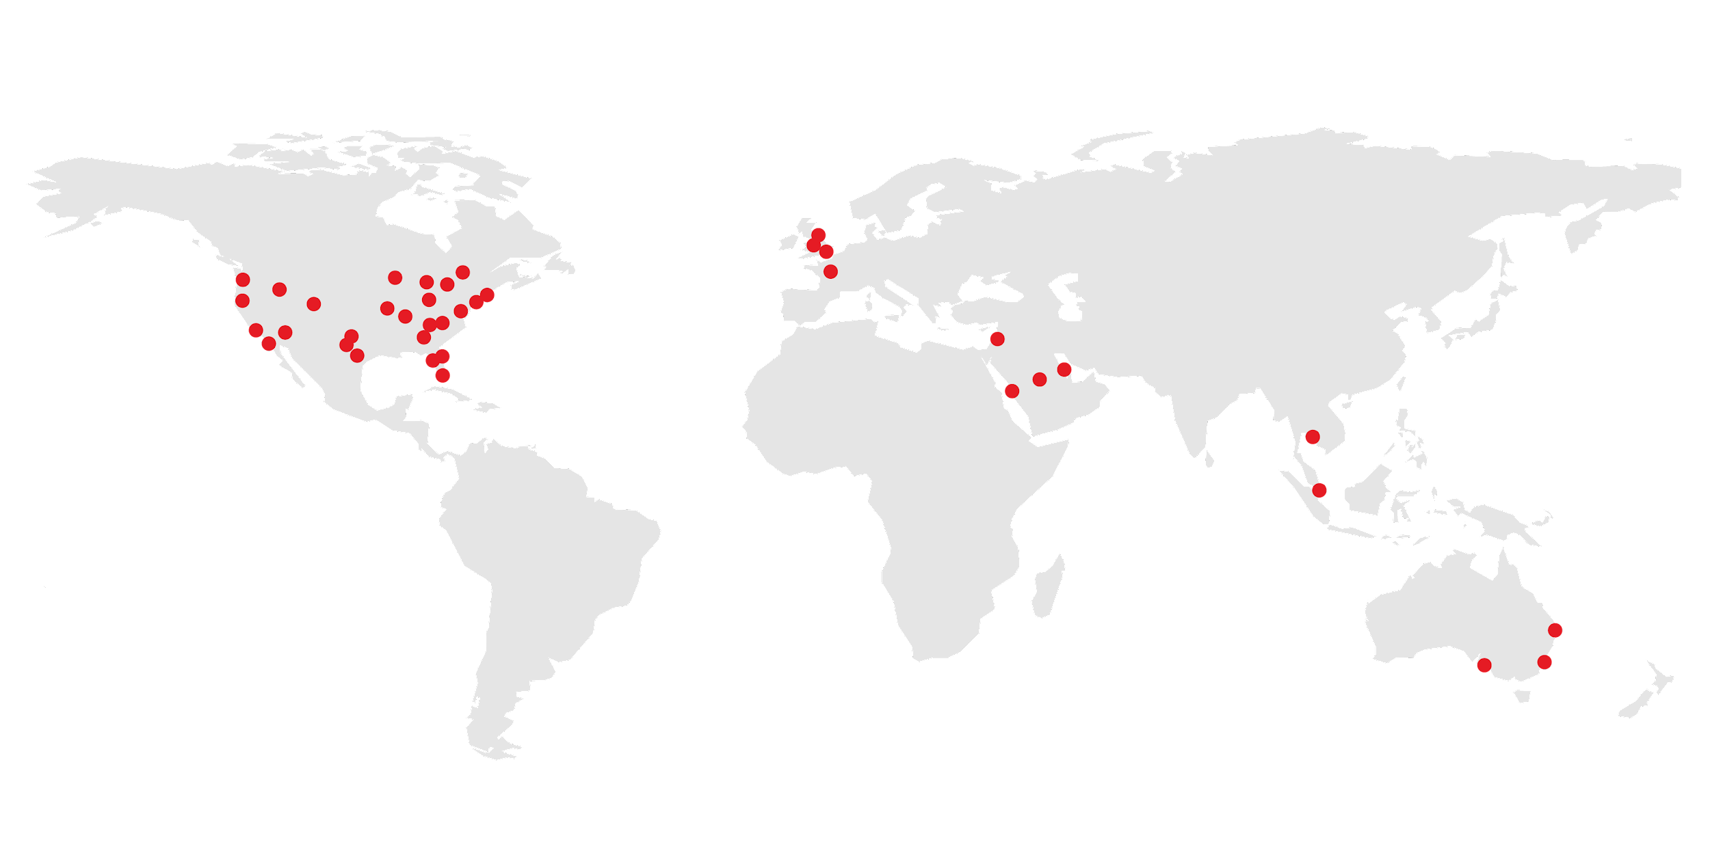
General Assembly is a pioneer in education and career transformation, specializing in today's most in-demand skills.
We foster a flourishing community of professionals pursuing careers they love.
Notes:
“Fast forward 10 years, we now offer more than 25 career-changing courses, online and at 20+ campuses around the world - from New York, to London, to Sydney and Singapore.
We also work with businesses and have trained more than 40 of the Fortune 100 companies!
We’re most proud of our 70,000+ immersive and part-time alumni, as well as the 600,000+ alumni of our classes and workshops (that’s YOU!)”

Slide 5









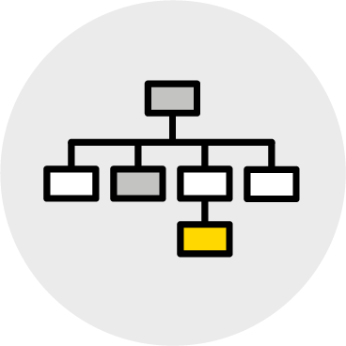


What can I learn at GA?
CODING
UX & DESIGN
DATA
BUSINESS
MARKETING
CAREER DEVELOPMENT
Notes:
Quick overview of course topics:
“You might be wondering, What can I learn at GA?
We offer courses in today’s most in-demand topics like coding, UX & design, data, business, marketing, and career development - with a range of commitment options to fit your lifestyle.”

Slide 6



How can I learn at GA?
Network-Building Workshops & Events
Career-Boosting Part-Time Courses
Career-Changing Immersive Courses
Online and on-campus happenings highlight leading innovations, technologies, and trends.
2 Hours - 2 Days
7 Days a Week
Level-up your skillset with opportunities spanning data, business, tech, and design.
40 Hours Total
Weeknights or 1-Week
Expert instruction, career coaching, and curriculum that keeps pace with employer demands.
40 Hours per Week
12 Weeks
Notes:
Quick overview of course formats:
“From events and worksohps to career-transforming immersives, our courses can fast-track you into the job you want with the industry skills you need. And they’re taught by real world industry experts — many of whom started right where you’re at today.”
*Add a quick blurb about where you started and how you got here today!

Slide 7
So we’re on the same page...

Slide 8
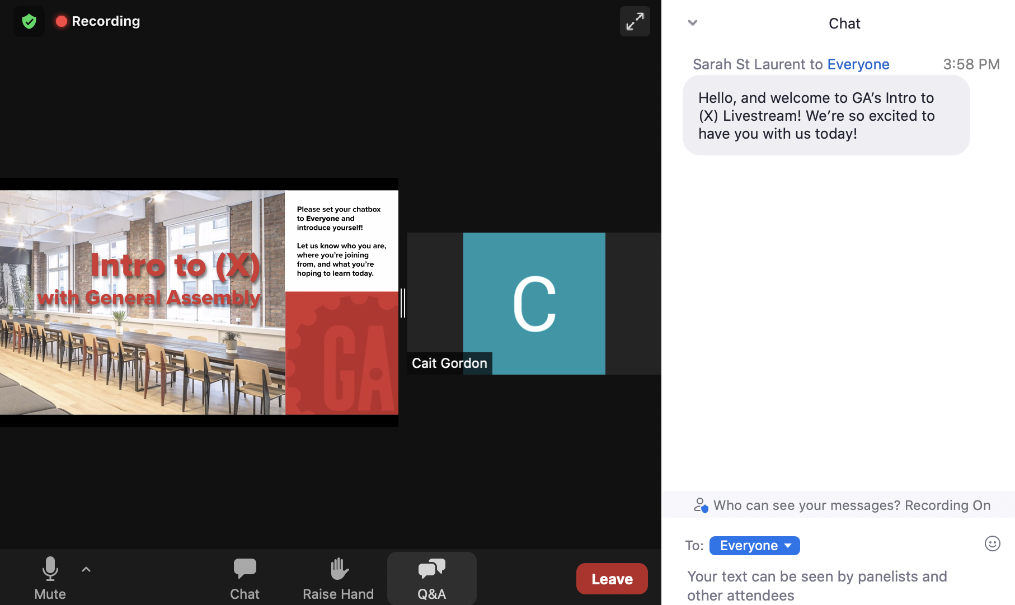
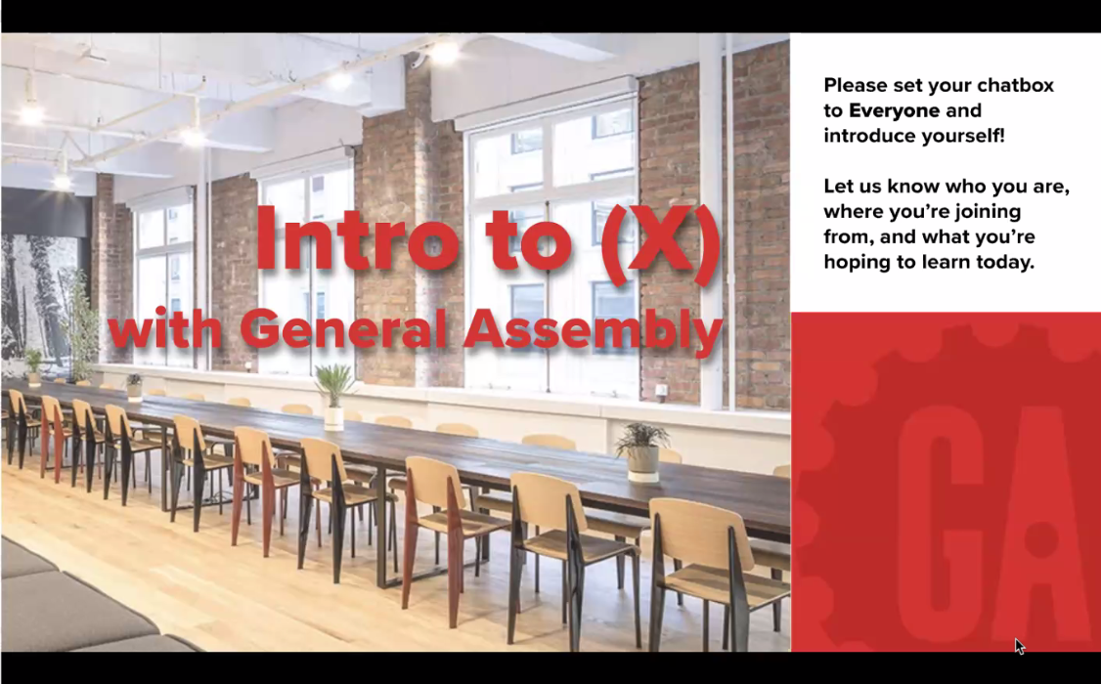

We want to hear from you!
Use the
Chat to participate in class discussions.
Set your chatbox to “Everyone” so that your classmates can see what you have to say!
Use the
Q&A function as a “parking lot” for general subject matter questions.
Notes:
TALKING POINTS:
Use the Chat for in-class participation and quick questions directly related to the content or conversation at hand, while the Q&A is reserved for general questions that will be addressed at the end (or throughout Q&A breaks in class).
Set a realistic expectation that this class has a lot to cover in 2 hours, so you’ll do your best to get to all the questions, but there may not be time for every single one

Slide 9
On the Agenda...
Keep in Mind...
Getting Started
Python Coding Basics
5 minute break
Modules
Python in Action
Survey / Next Steps
Q&A
This is a beginner level overview of Python
There will be time at the end for Q&A.
You’ll receive the recording and slides from today’s class within 2-3 business days after filling out the feedback survey.
Notes:
*Agenda font can be resized if you need to fit more bullet points!

Slide 10

By the end of class, you’ll be saying...
I can explain how Python fits into the data and web workflow.
I am confident running basic Python programs.
Python is not nearly
as intimidating as I thought,
I can’t wait to
keep practicing!
I understand fundamental Python techniques and tools.
Notes:
Explain: By the end of this class, you’ll be saying... (read the above).
You can update the wording and add or remove text boxes to fit your content
Takeaways can also be found on the class page for your topic

Slide 11
Let’s Get Started!

Slide 12

What is Python, exactly?
Created by Guido Van Rossum in 1991.
High level programming language that can be used to automate administrative tasks or create large scale applications.
Simple, easy to use syntax that emphasizes readability.
Python is an interpreted language, meaning that it has an extremely quick change, test, debug cycle.
Notes:
All of these combined provide for increased productivity over other languages.
FUN FACT: Python got its name after Monty Python’s Flying Circuis, a show Guido Van Rossum enjoyed.

Slide 13

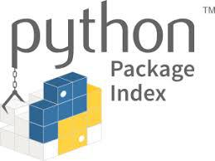



Why is Python so popular?
It combines the best of both worlds to automate tasks and build applications.
It has a large development community
Access free software from the Python community with Pypi.org
It’s widely applicable
Build web apps
Build video games
Organize/plot data
Notes:
Widely applicable:
Can build web applications using django. Some companies using django include YouTube and Instagram
Can build video games using Pygame.
Can organize and plot data using matplotlib
Other areas of Python application include information security, data science, and artificial intelligence
Large development community:
Python has been around for 30 years and has gained a huge following
Pypi.org is a repository of software for Python that lists freely available software that has been developed and shared by the Python community
Best of both worlds:
Python started out as a scripting language and is still heavily used today for automating repetitive tasks, such as account creation, server maintenance, etc... But is also robust enough for building production ready applications in all of these areas

Slide 14


Running Python Programs
We’re going to use Spyder from inside Anaconda Navigator!
Notes:
On your machine:
Open Anaconda Navigator
Launch Spyder from it’s application tile
Show the students how to run a simple program by typing: print(“hello class”) and pressing the play button

Slide 15
Python Coding
Basics

Slide 16
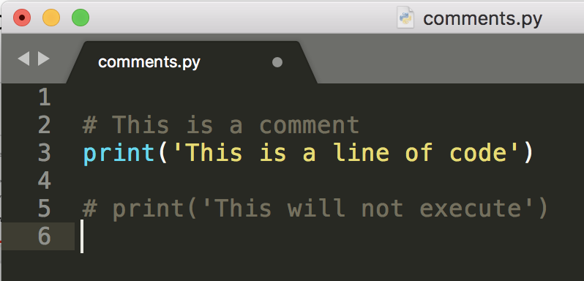
Comments
Example:
Start with a # symbol
Prevent code from executing
Are used to provide contextual information
Notes:
Comments:
Start with a # symbol and tell the Python interpreter to ignore everything from that symbol to the end of the line
Will also prevent any code after the # symbol from being executed
Can be used to add documentation to your code or as a quick way to find errors by “commenting out” suspect code

Slide 17
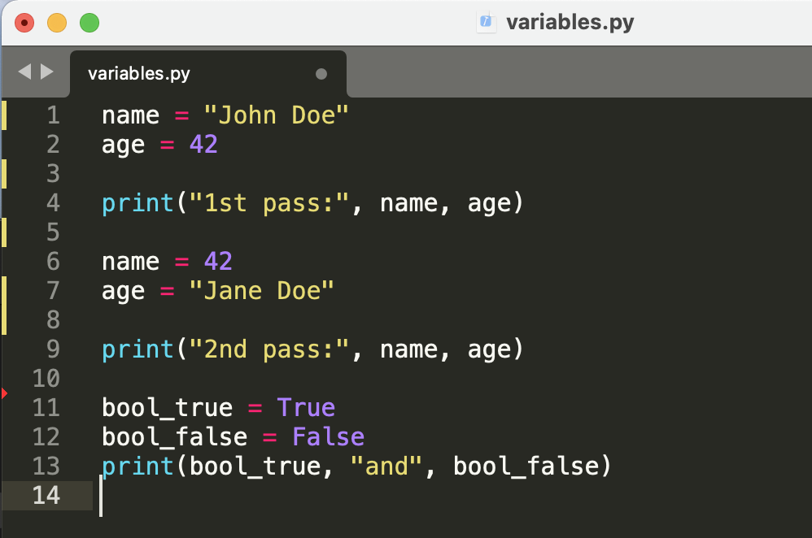
Variables
Example:
Used to store a value
Names can start with letters or underscores and can contain numbers
Should not be Python keywords
Basic types are numbers, strings, and booleans
Notes:
Variables
Serve as a place to temporarily store information that our code will need to retrieve later on

Slide 18
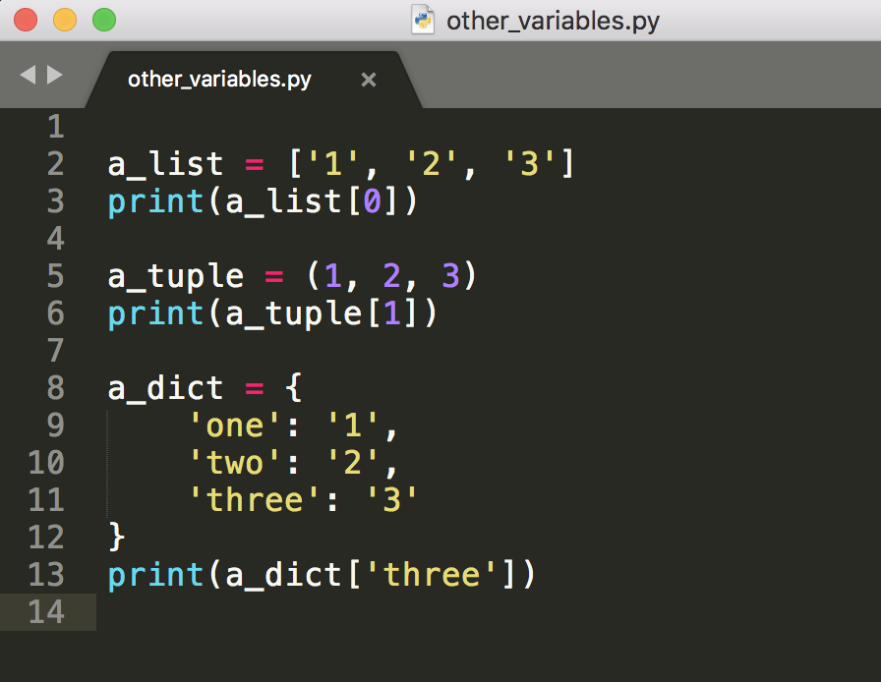
Variables
Example:
Lists = [ ]
Dictionaries = { }
Hold multiple values
Are very similar in use
Notes:
Collections:
Lists and maps are 2 of the most common, although there are others
Used to hold multiple values, such as email addresses retrieved from a database
A list uses the position of an element it contains to refer to that value
Positions start with 0 and the last position will always be the length of the list - 1
We can use the position, by placing the position number insite of square brackets after the variable name, to retrieve and change values in a list
A map uses key/value pairs instead of a numerical position to store values
A value can be retrieved or changed by writing the key inside of square brackets after the variable name

Slide 19
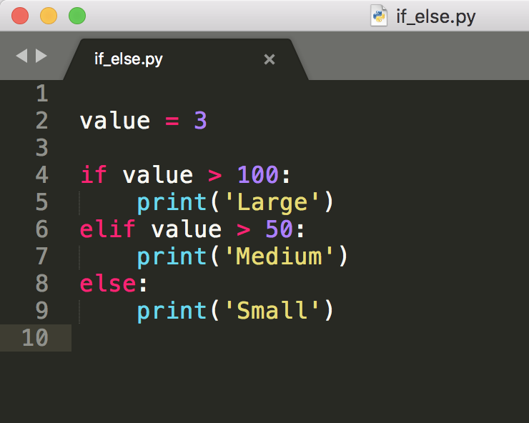
If Statements
Example:
Allow us to make decisions based on a certain criteria
Use conditional tests to determine whether or not to execute a block of code
Only one code block gets executed
Can have a default block if none evaluate to true
Notes:
If/then/else statements:
Start with the keyword “if” and an expression, if the expression results in a true value, then the block of code will be executed
We can combine more than one if statements using the “elif” keyword
Finally, we can define a default block using the “else” keyword. The body of the else block will run in the event that all of the other “if” and “elif” expressions are false
Code out this example in spyder and change the value variable to make each of the code segments run

Slide 20
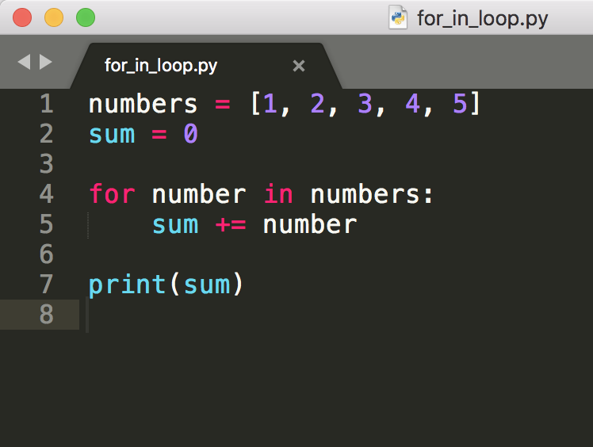
Loops
Example:
Used to perform an operation on each member of a collection of data
One of the most common types is the for . . . in loop
Notes:
Loops:
Commonly used to visit each element in a collection and perform some action on their value
Can also be used to perform a set of tasks a certain number of times
In a for in loop, the next value in the collection is automatically assigned to the variable provided after the “for” keyword
This is just one of many ways that you can write a loop

Slide 21

Five Minute Break

Slide 22
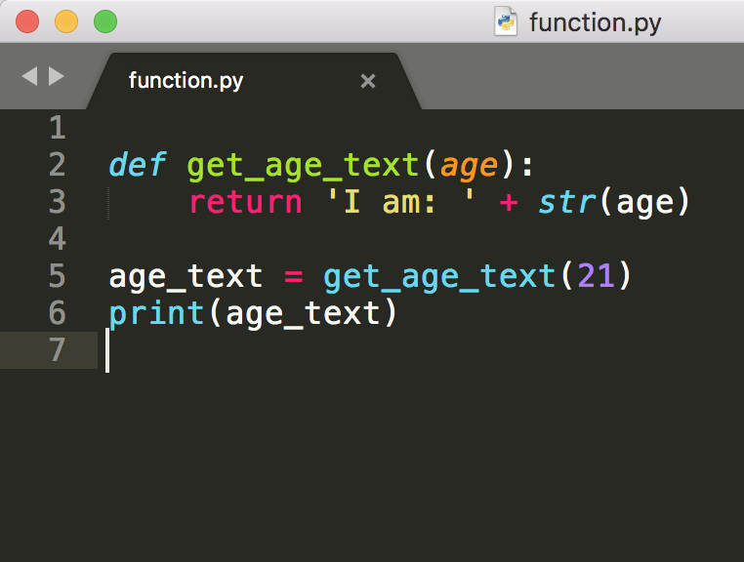
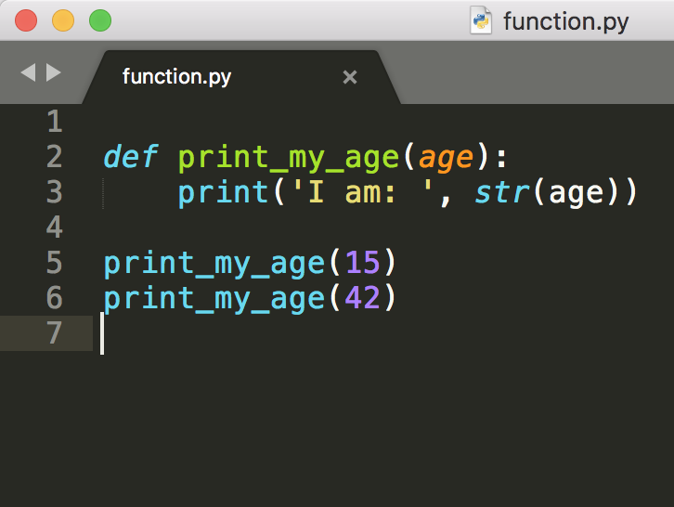
Functions
Example:
Named blocks of code that perform a specific job
Called using the name of the function
Alleviates the need for writing the same code multiple times
May return a value
Notes:
Functions:
Defined using the “def” keyword, followed by the name of the function and a set of parenthesis
If the function needs to take in one or more values, we provide a comma-separated list of variables inside the parenthesis

Slide 23
Modules

Slide 24

So, how do I take advantage of the Python development community?
Notes:
We’ve learned a lot about some of the basic pieces of Python, but how do I use modules to enhance my own programs?

Slide 25

Installing Modules
Just a few steps and we’re all set!
Anaconda Navigator
The Environments tab
Shows us a list of modules that have been installed
Import <package> [as <alias>]
Notes:
Make sure the module that you want to use has been installed in your Python environment
The “installed” dropdown under the Environments tab shows us all of the modules that have been installed in our environment
If we change this to “not installed” we see all of the others that we could install
Make sure matplotlib show up when we select “installed”, if not:
Select “not installed”
Scroll down to matplotlib
Check the box next to matplotlib
Click “apply” to download and install that module
Once we’ve installed a module, we can use it in our own Python program using an import statement
Imports are declared at the top of the file
Imports can be renamed in our programs using the “as” keyword

Slide 26
Python in Action!
Notes:
Code through the graphing exercises explaining each line as you go. Start with the plot of squares followed by the Georgia unemployment exercises.
https://drive.google.com/file/d/1tdZzInXcznYpE1SsDdIBV3C471UK2Wl0/view?usp=sharing
Encourage participants to follow-along if they have a second monitor. Remind them that if they’re unable to follow-along live, they can sit back and soak it in for now, and they’ll be able to recreate this class on their own time when they receive the slides and recording.

Slide 27

You did it! Way to go!
Notes:
Congratulations! You took a step toward improving your Python skills, and should be so proud of yourself!

Slide 28
Recap...
Reminder...
By now, you should have a solid understanding of:
Python coding basics - Comments, Variables, If Statements, Loops, and Functions
Installing Modules
How to run basic Python programs
You’ll receive the recording and slides from today’s class within 2-3 business days after filling out the feedback survey.

Slide 29
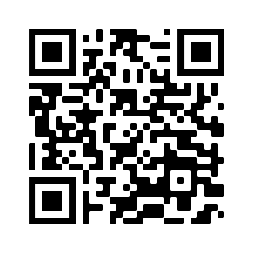
https://ga.co/introfeedback-apac
Let us know
what you thought
of today’s class!
“Feedback is a free education to excellence” - Ann Marie Houghtailing
Notes:
Congratulations! You took a step toward improving your Data Analytics skills, and should be so proud of yourself!

Slide 30
Where do I go from here?

Slide 31


Continue on your learning journey!
Browse Workshops & Bootcamps
Ranging from 2 hours to 2 days
Instructor Led
Online
Browse Part-Time Courses
40 hours, evenings or 1-week accelerated
Instructor Led
Online
Browse Immersive Courses
12 weeks, 40 hours / week
Instructor Led
Career Coaching
Online
Notes:
Check out these links when you receive your copy of the slides to browse all of your continued learning options with GA!

Slide 32
Questions?

Slide 33
Thank you!

